Slide 1
Traffic road signs detection
Theoretical foundations

Slide 2



Problem
Detect road signs in color images
Road sign shapes: circular, triangular, rectangular
Evidently road signs have different colors

Slide 3
Proposed solution
Shape detection
Color detection
Identify the road sign by combing the two

Slide 4
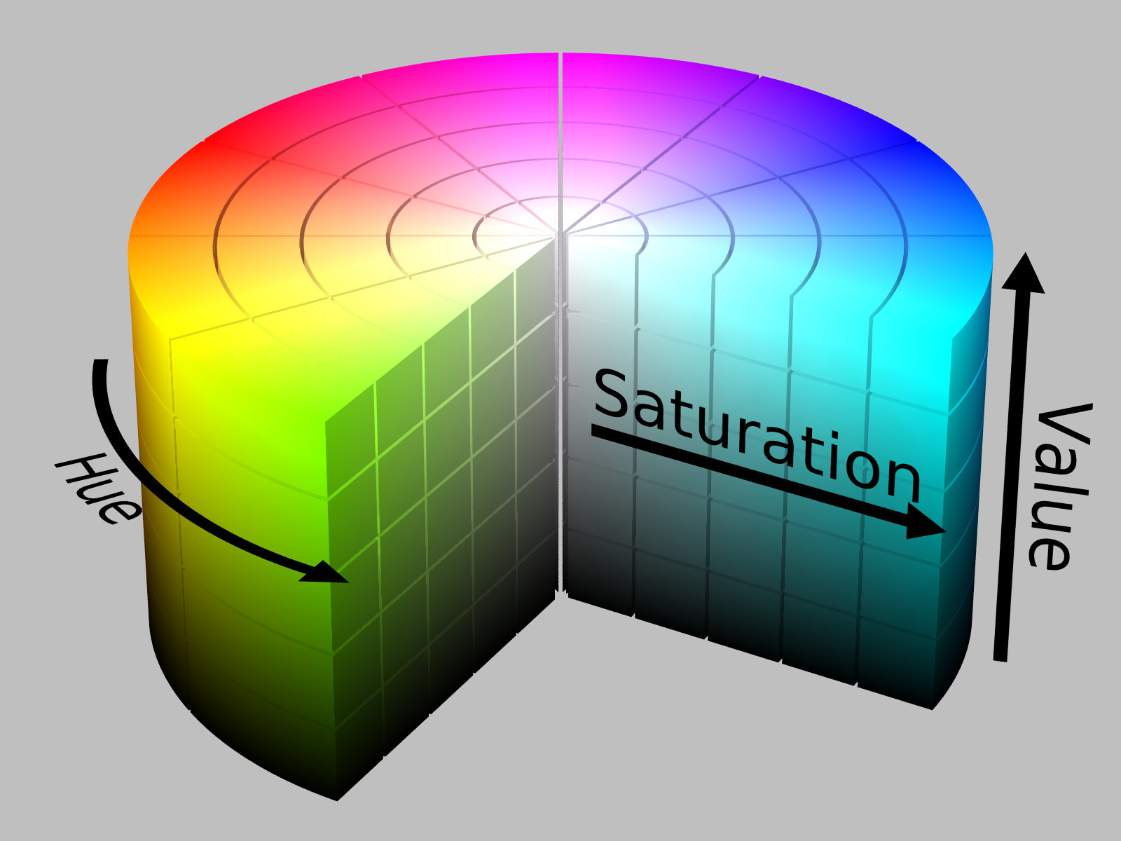
Color detection
Detect color in any lighting condition: HSV

Slide 5
Color detection – HSV
HSV representation is useful for this task:
Hue: similar to perceived color (what we want to detect)
Saturation: colorfulness relative to lightness (we can mostly ignore it if it is high enough)
Value: lightness (we can mostly ignore it if it is high enough)
This way color is detected despite lighting conditions.

